Slide 1
Priority 4 – Improved knowledge mobilization and transfer
Champions: Sheri Strydhorst, Drew Lyon, and Kenton Porker
January 2020 – FINAL RESULTS

Slide 2
Survey Background Information
GOAL 4.1 : Better understand how knowledge mobilization and transfer systems can be adapted to meet regional needs in a digital world.
ACTION: Conduct a GROWER survey of what knowledge transfer tools are working in different jurisdictions.
Extension or knowledge transfer is the process of driving practice change using a variety of educational methods and communication tools. In the United States, extension is within the Land Grant University system. In other countries it resides in state, provincial or federal government, private and non for profit farming system groups, crop advisors, or it may not be formally mandated by any group.

Slide 3
Responses to the Farmer Survey:
208 survey responses (October 15 – December 31, 2019)
145 Canadian responses
55 USA responses
6 Australian responses
2 did not indicate where they farm
NO responses from Europe, Asia, Africa, South America
Major gaps among the community

Slide 4
Canadian Responses – 145

Slide 5
USA Responses – 55

Slide 6
Australian Responses – 6

Slide 7
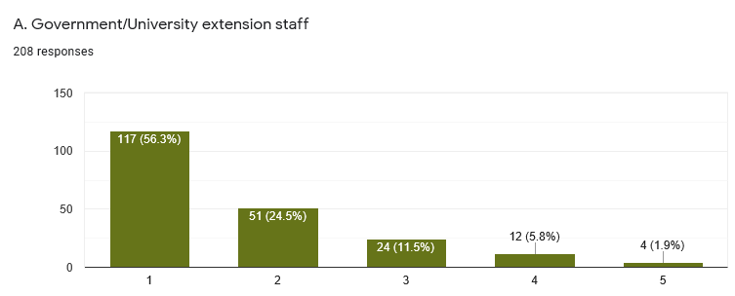
Q1. Farmers have many sources of wheat agronomic information. As a farmer, how do you know the information is credible? Ranked as 1 = most trusted; and 5 = least trusted
56% of respondents rank
Government/University Extension Staff
as their most trusted source
of agronomic information
MOST TRUSTED LEAST TRUSTED

Slide 8
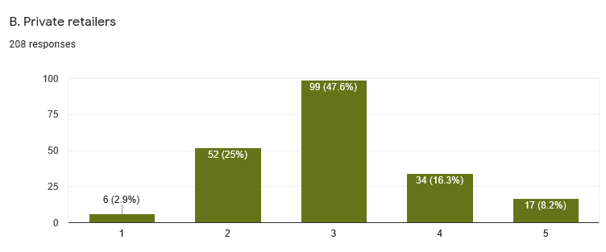
Q1. Farmers have many sources of wheat agronomic information. As a farmer, how do you know the information is credible? Ranked as 1 = most trusted; and 5 = least trusted
Only 3% of respondents rank Private Retailers
as their most trusted source
of agronomic information
MOST TRUSTED LEAST TRUSTED

Slide 9
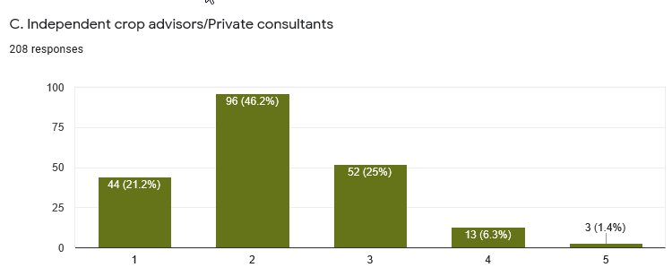
Q1. Farmers have many sources of wheat agronomic information. As a farmer, how do you know the information is credible? Ranked as 1 = most trusted; and 5 = least trusted
21% of respondents rank Independent Crop Advisors/Private Consultants as their most trusted source
of agronomic information
MOST TRUSTED LEAST TRUSTED

Slide 10
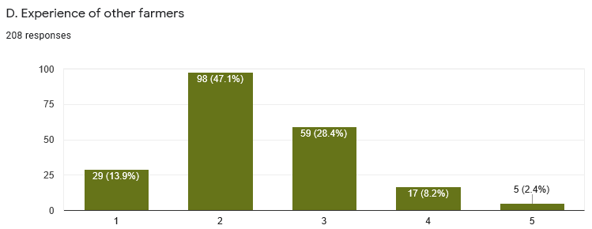
Q1. Farmers have many sources of wheat agronomic information. As a farmer, how do you know the information is credible? Ranked as 1 = most trusted; and 5 = least trusted
14% of respondents rank Experience of Other Farmers as their most trusted source
of agronomic information
MOST TRUSTED LEAST TRUSTED

Slide 11
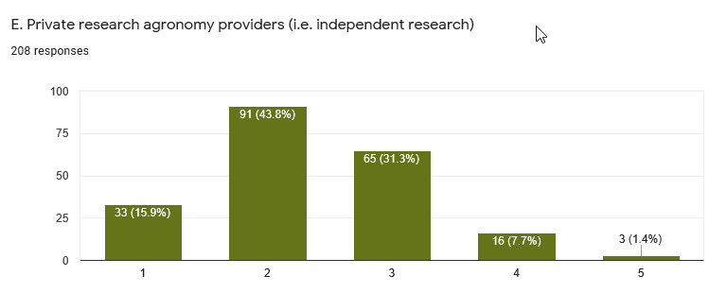
Q1. Farmers have many sources of wheat agronomic information. As a farmer, how do you know the information is credible? Ranked as 1 = most trusted; and 5 = least trusted
16% of respondents rank Private Research Agronomy Providers as their most trusted source
of agronomic information
MOST TRUSTED LEAST TRUSTED

Slide 12
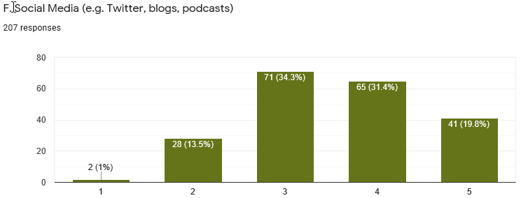
Q1. Farmers have many sources of wheat agronomic information. As a farmer, how do you know the information is credible? Ranked as 1 = most trusted; and 5 = least trusted
Only 1% of respondents rank Social Media as their most trusted source
of agronomic information
MOST TRUSTED LEAST TRUSTED

Slide 13
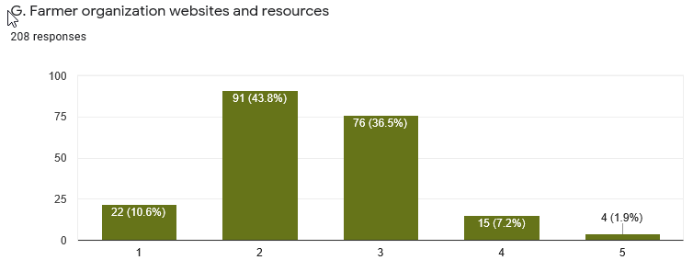
Q1. Farmers have many sources of wheat agronomic information. As a farmer, how do you know the information is credible? Ranked as 1 = most trusted; and 5 = least trusted
11% of respondents rank Farmer Organizations as their most trusted source
of agronomic information
MOST TRUSTED LEAST TRUSTED

Slide 14
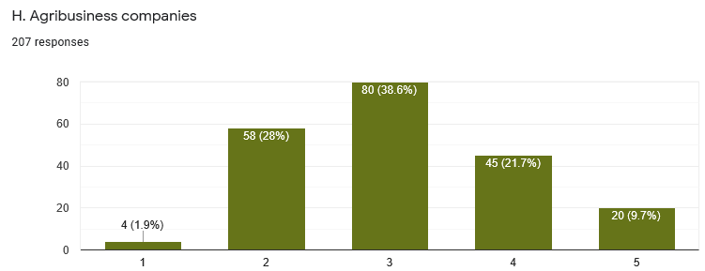
Q1. Farmers have many sources of wheat agronomic information. As a farmer, how do you know the information is credible? Ranked as 1 = most trusted; and 5 = least trusted
2% of respondents rank Agribusiness as their most trusted source
of agronomic information
MOST TRUSTED LEAST TRUSTED

Slide 15
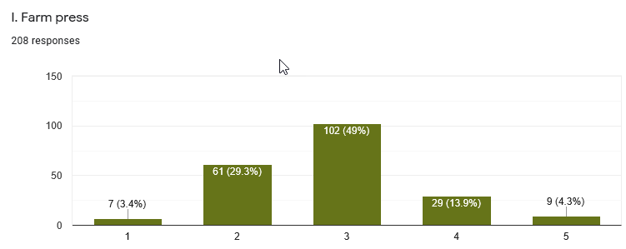
Q1. Farmers have many sources of wheat agronomic information. As a farmer, how do you know the information is credible? Ranked as 1 = most trusted; and 5 = least trusted
3% of respondents rank Farm Press as their most trusted source
of agronomic information
MOST TRUSTED LEAST TRUSTED

Slide 16
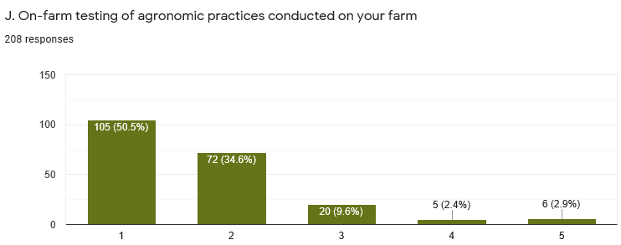
Q1. Farmers have many sources of wheat agronomic information. As a farmer, how do you know the information is credible? Ranked as 1 = most trusted; and 5 = least trusted
51% of respondents rank Testing of Agronomic Practices on their own farm as their most trusted source of agronomic information
MOST TRUSTED LEAST TRUSTED

Slide 17
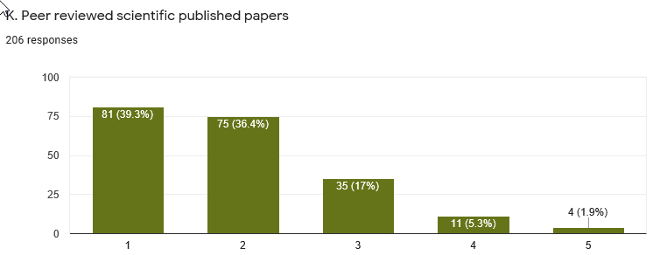
Q1. Farmers have many sources of wheat agronomic information. As a farmer, how do you know the information is credible? Ranked as 1 = most trusted; and 5 = least trusted
39% of respondents rank Peer Reviewed Scientific Papers as their most trusted source of agronomic information
MOST TRUSTED LEAST TRUSTED

Slide 18
Summary of Trusted Sources
The most trusted sources of agronomic information are:
Government/University Extension Staff and On-Farm Testing of Agronomic Practices Conducted on Farm
The least trusted sources of information are:
Social Media, Agribusiness Companies, Private Retailers, Farm Press
Surprisingly Farm Organizations and Independent Crop Advisors/Private Consultants were not a “most trusted” source of information

Slide 19
Other Sources of Trusted Information Were:
Other farmer test plots
Local research associations
Certified crop advisors
OMAF – quality and unbiased work
On Farm Well Designed Research – NOT demos
(Note: References to specific individuals were not included)

Slide 20
Q2. How do you like to receive extension information? Please mark all that apply.

Slide 21
Q3. Of the extension delivery methods listed above, what 2 methods do you like the most?
Crop Walks and Fact Sheets
were the top 2 extension methods
preferred by growers
Notable comments: Presentations by researchers not salesmen; multi-stakeholder events where famers and researchers can interact; CCAs; websites can be referenced again but can’t beat in person

Slide 22
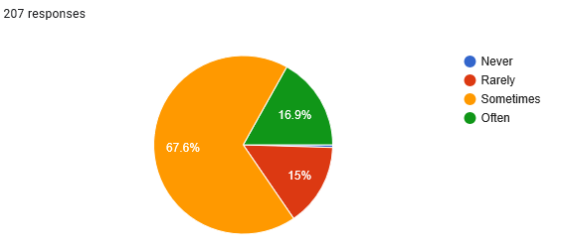
Q4. Do you think incorrect agronomic information is circulated to growers?
85% of survey respondents think incorrect wheat agronomic information is sometimes or often circulated to growers!

Slide 23
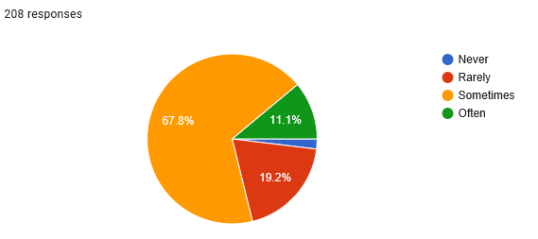
Q5. Do you struggle to determine credible vs. non-credible agronomic information?
87% of survey respondents sometimes or often struggle to determine credible vs. non-credible agronomic information.

Slide 24
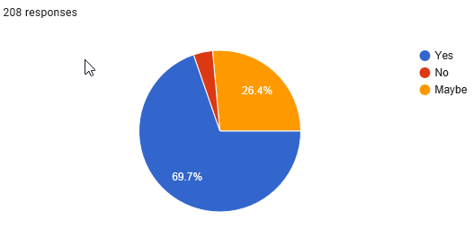
Q6. If wheat agronomic information were branded with a Wheat Initiative Logo (meaning that it has been confirmed by leading and well respected scientists), would this be useful for identifying credible information?
70% of survey respondents indicated information branded with the Wheat Initiative Logo would be helpful in identifying credible agronomic information.

Slide 25
Q7. Would you actively seek out agronomic information on a website lead by the Wheat Initiative Agronomic Expert Working Group?
72% of growers would actively seek out information on a Wheat Initiative Agronomic Expert Working Group Website.

Slide 26
Appendix 1
Survey 1 – Agronomist Survey Results from July 2019

Slide 28
Q1. Farmers have many sources for wheat agronomic information. Please rank the following resources used by farmers in your area to gain credible wheat agronomic information
Other: Study groups of commercial farmers

Slide 29
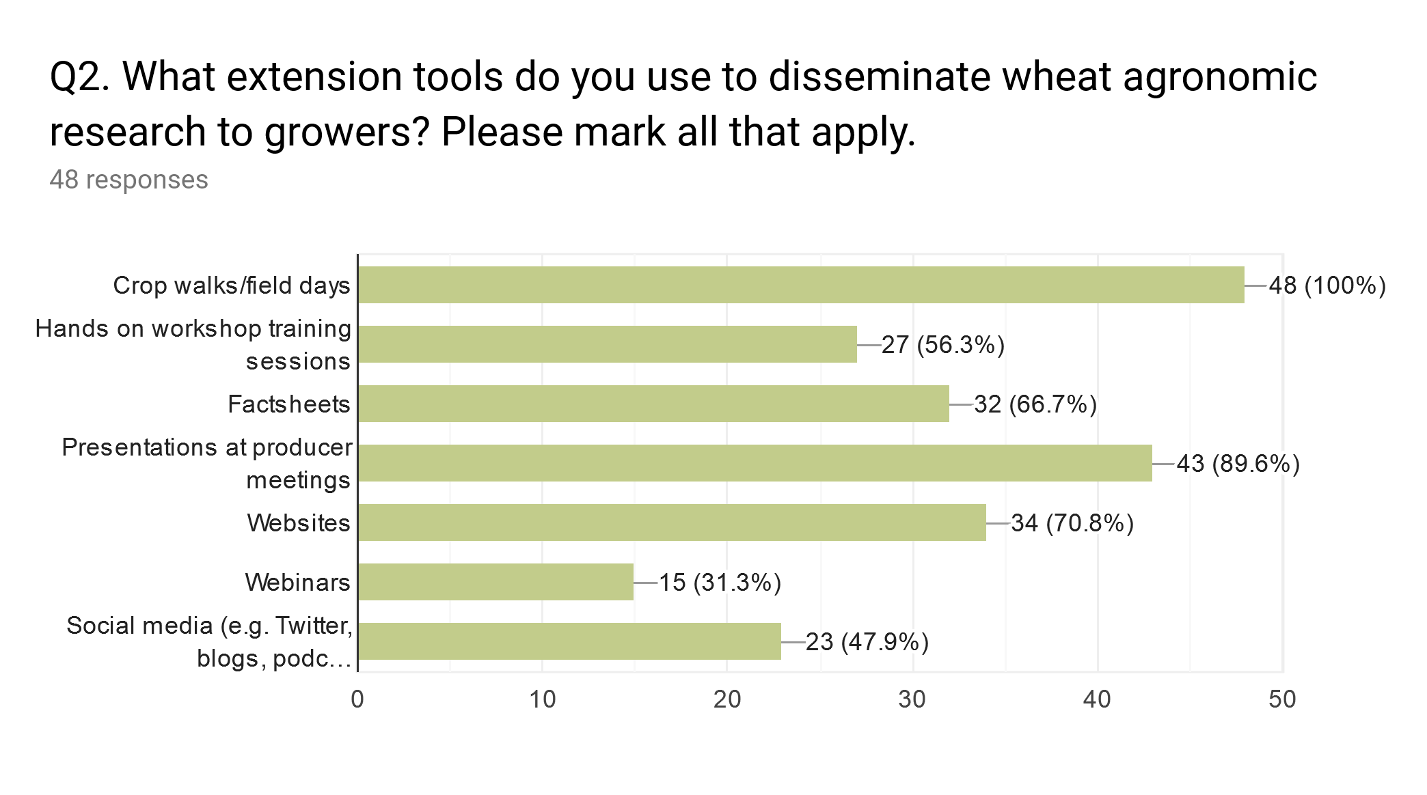

Slide 31
EU, CANADA, AUSTRALIA and USA ONLY

Slide 32
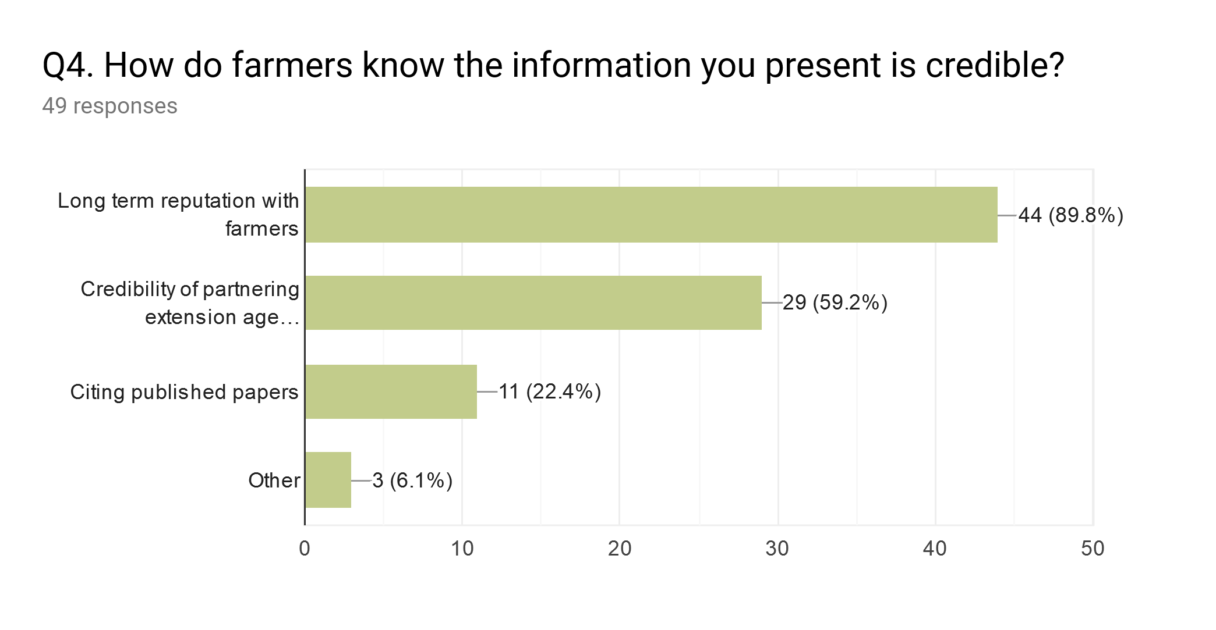
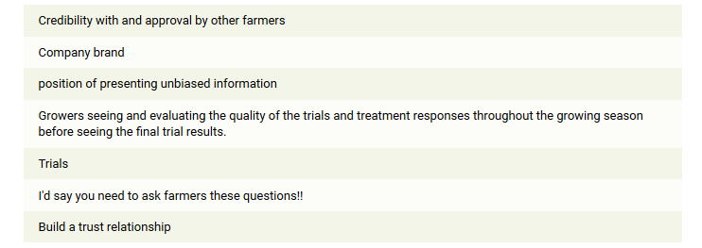
extension agencies
Other methods of “proving” credibility:

Slide 33
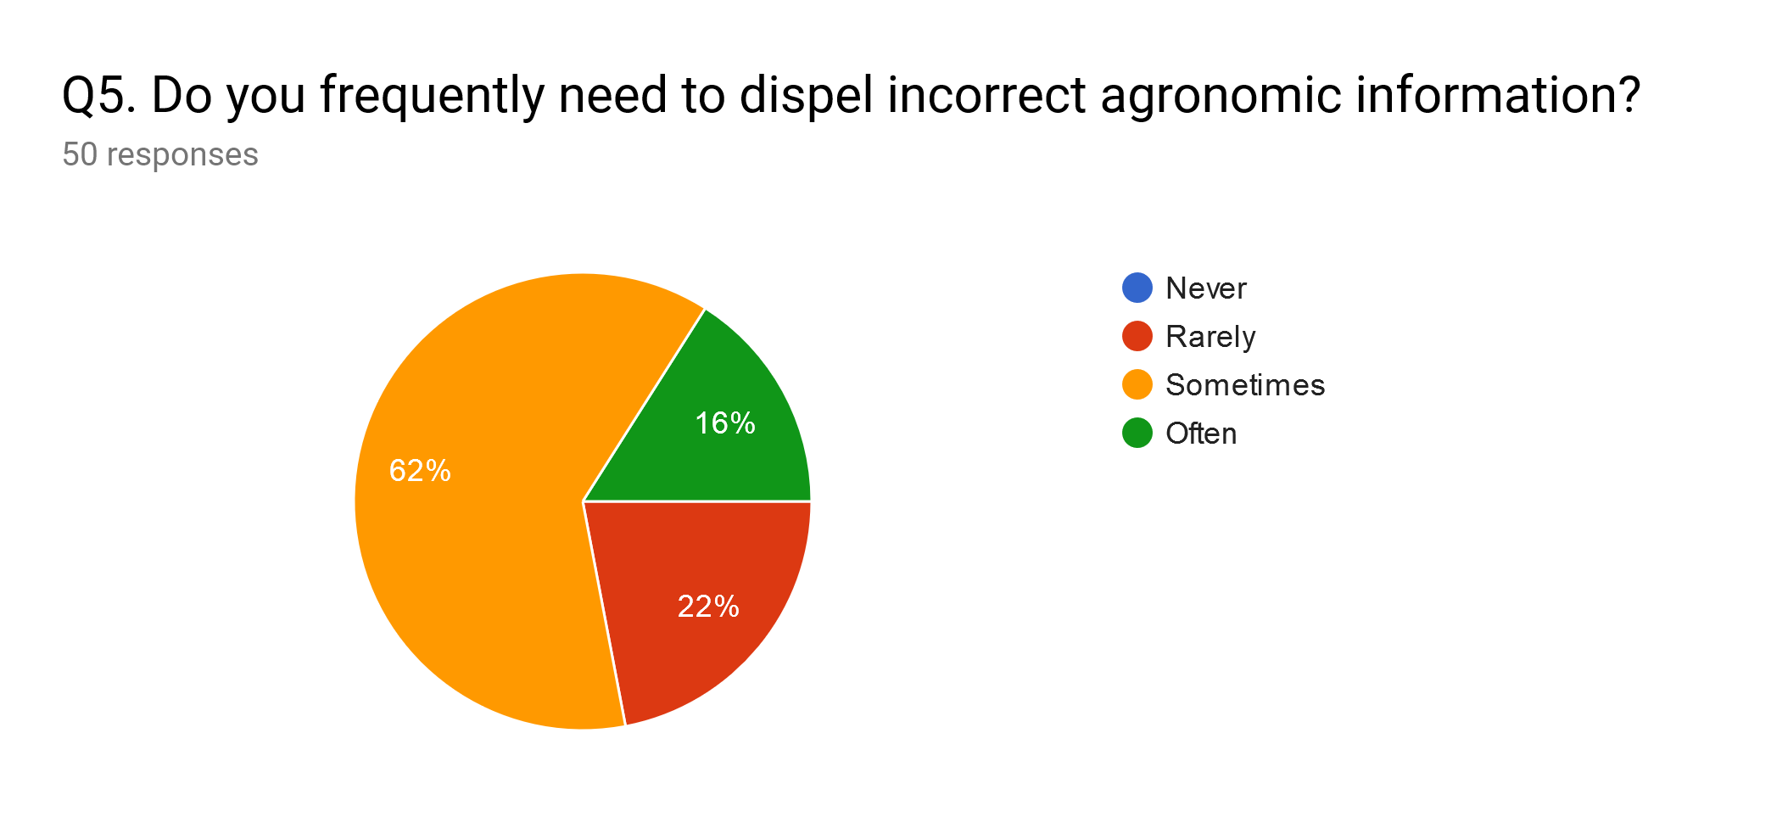
78% replied sometimes or often
often
sometimes
rarely

Slide 34
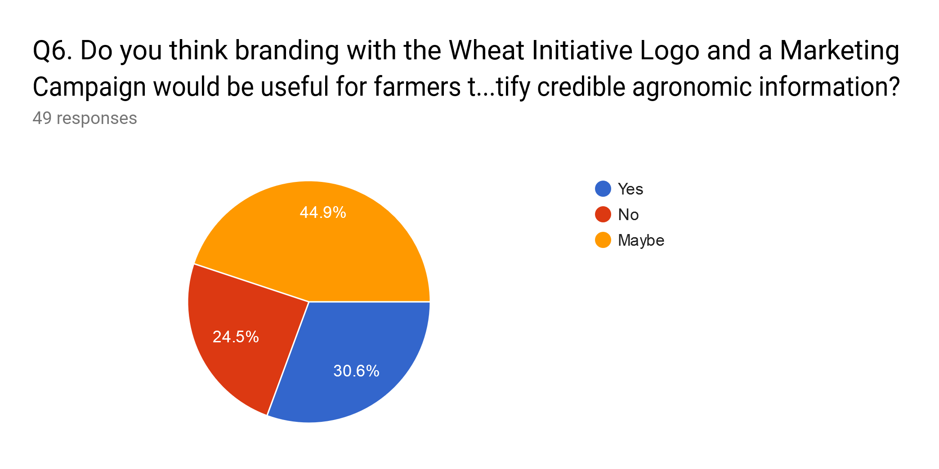
to identify credible agronomic information?
75.5% may or do support Wheat Initiative branding and marketing campaign

Slide 35
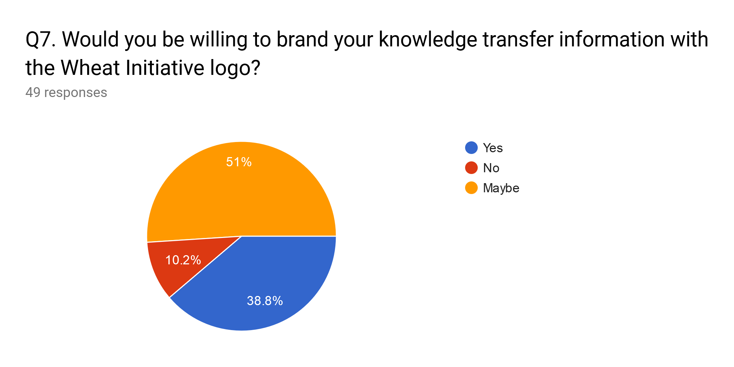
89.8% may or do support Wheat Initiative logo branding

Slide 36
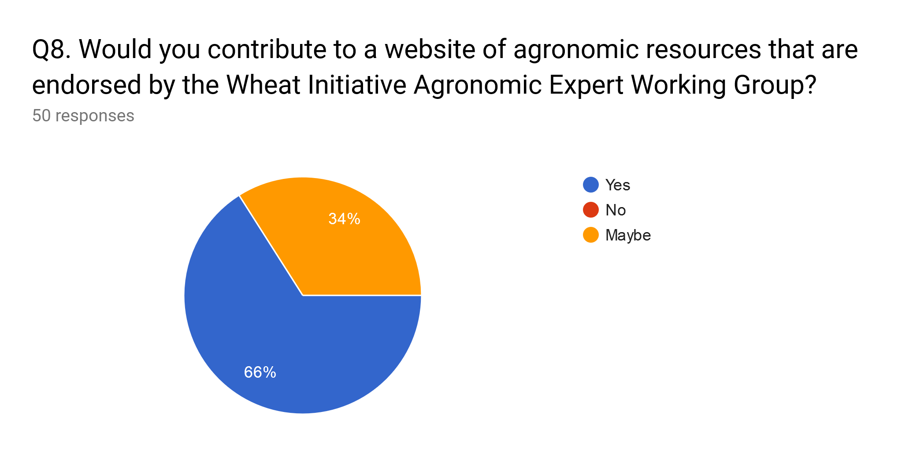

Slide 37
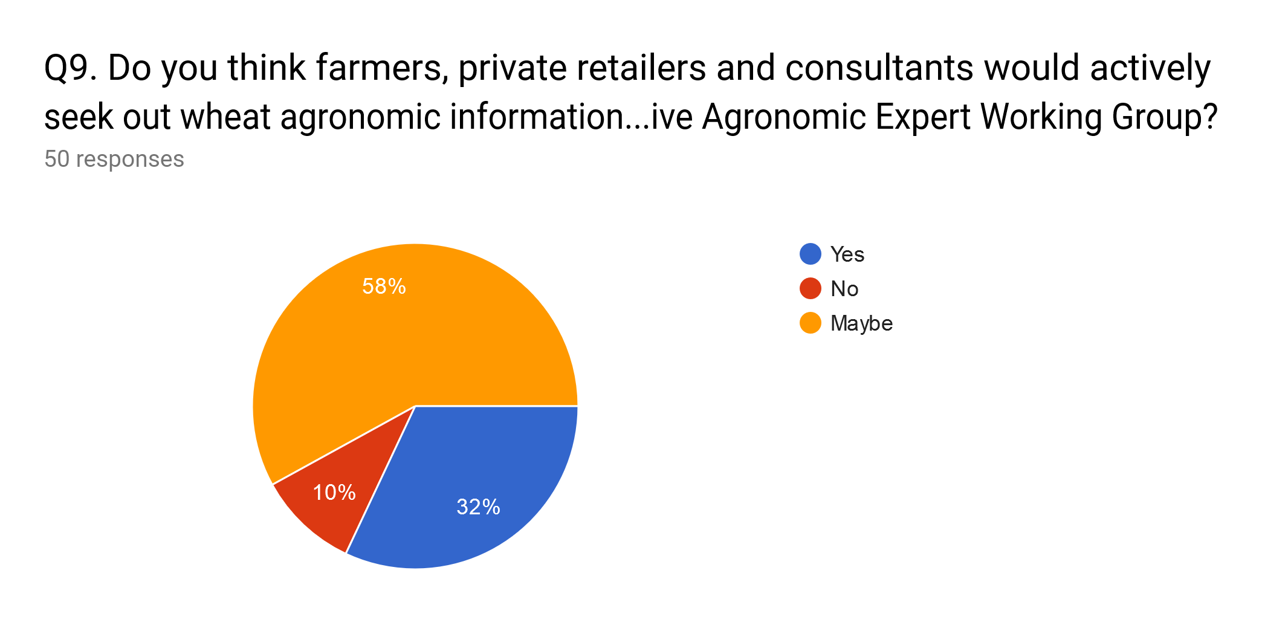
Would a WI website be used ?
on a website lead by the Wheat initiative Agronomic Expert working Group?
90% might or do believe Wheat Initiative Agronomic Expert Working Group website would be actively used

Slide 38
other crops.
I spend ___ % of my time working on wheat:
52% of survey respondents spend half or less than half their time working on wheat
48% of survey respondents spend more than 60% of their time working on wheat

